Slide 1



EXPRESSO CUSTOMER CHURN PREDICTION
By: Gyimah Gideon
Email: gideongyimah19@gmail.com

Slide 2
EXPRESSO CUSTOMER CHURN
PREDICTION
ABOUT EXPRESSO
PROJECT OVERVIEW
Expresso is an African company. It provides telecommunication services in three African markets: Mauritania, Senegal, and Sudan. Expresso is a key player in the implementation of the Africa Coast to Europe (ACE) submarine cable.
To be the leading ICT provider in the region. Innovate extraordinary ICT services to better peoples’ lives everywhere, achieve remarkable value for all stakeholders, and inspire talent across the entire organization to proudly lead with excellence
STEPS
Typically, telecom company like Expresso provide infrastructure to enable clients to transmit voice, video, and data. When a customer (subscriber) discontinues his or her association with the company, this is referred to as customer churn. Businesses usually consider a client to be churned after a certain length of time has passed since the consumer’s last interaction with the site or service.
Client turnover must be reduced since the cost of obtaining a new customer is higher than the cost of retaining an existing one. In this project, we aim to find the likelihood of a customer leaving the organization, the key indicators of churn as well as the retention strategies that can be implemented to avert this problem.
Business understanding.
Data understanding.
Data preparation.
Modeling.
Evaluation.
Deployment.
VISION/MISSION
Objective

Slide 3
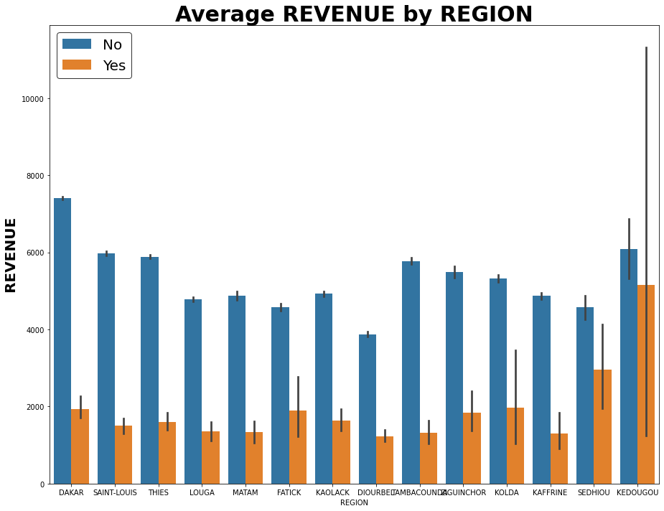
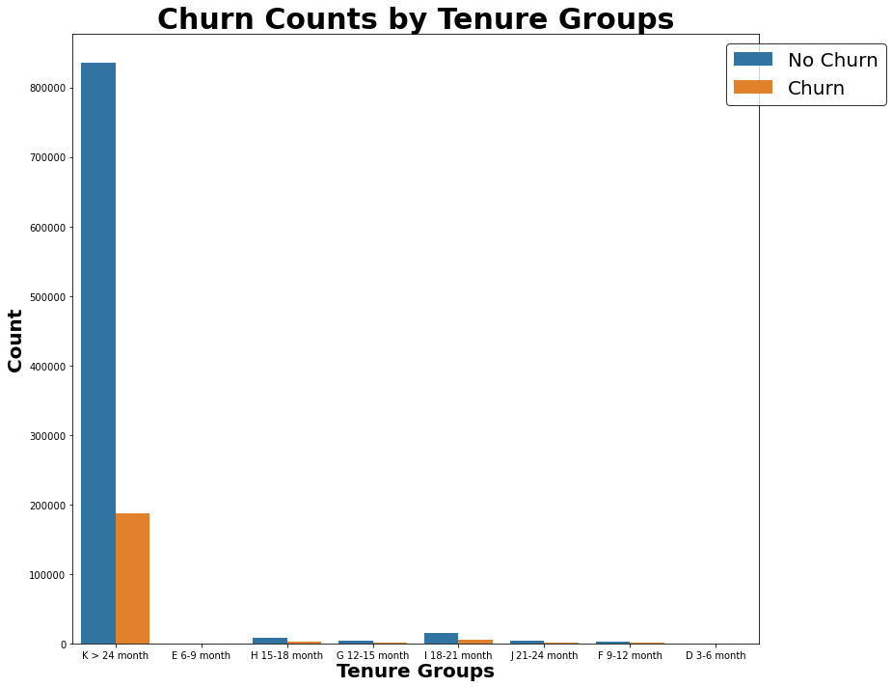
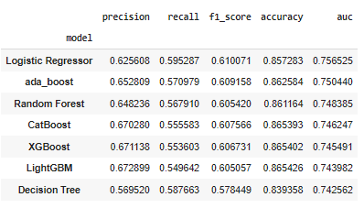
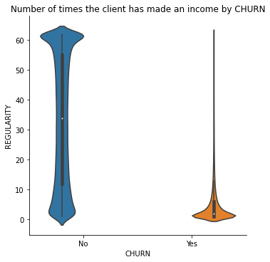
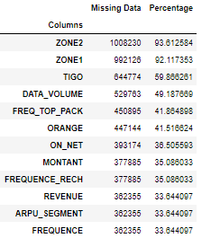
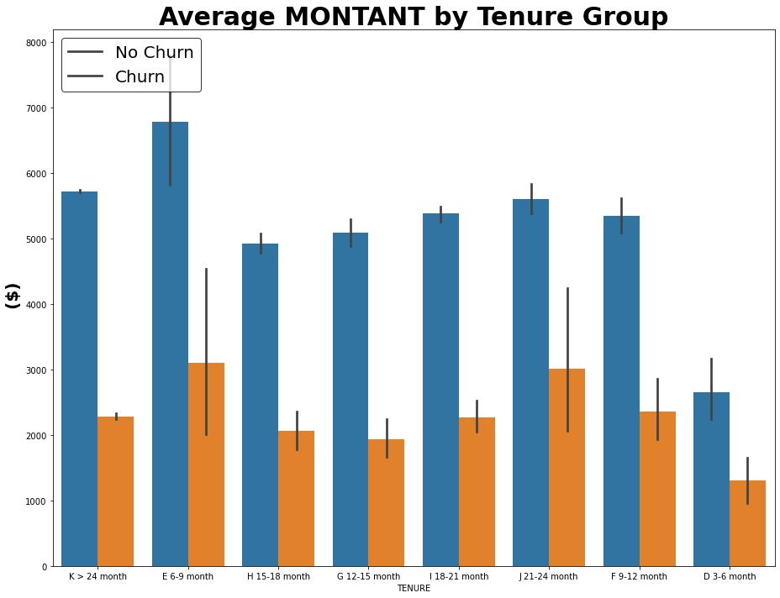
EXPRESSO CUSTOMER CHURN PREDICTION
(Data Understanding,Preparation, and Modeling)
DATA VISUALIZATION
DATA VISUALIZATION
DATA REDUCTION
19 Variables
Feature Engineering
12 Variables
I was INTERESTING to see that Tenure group between 6-9 months are those with high revenue. No wonder their top-up-amount is also high...They are those who churn most also
Customers with shorter service tenures (newer clients) are more likely to churn than those with longer tenures....so most of the people who left service had less tenure
MODEL SUMMARY
DATA EXPLORATION
It can be seen that client churn when the Number of times a he or she has made an income is between 0-10
Note:
The above summary is for my training on the unbalanced dataset
Data is partitioned into 80% Training; 20% Validation when building the model with the unbalanced dataset 70/30 with balanced dataset
Those who have been staying with the company between 6-9 months Churn most, and they are also the people with high top-up-amount
Notes:
Single sided poster!

Slide 4
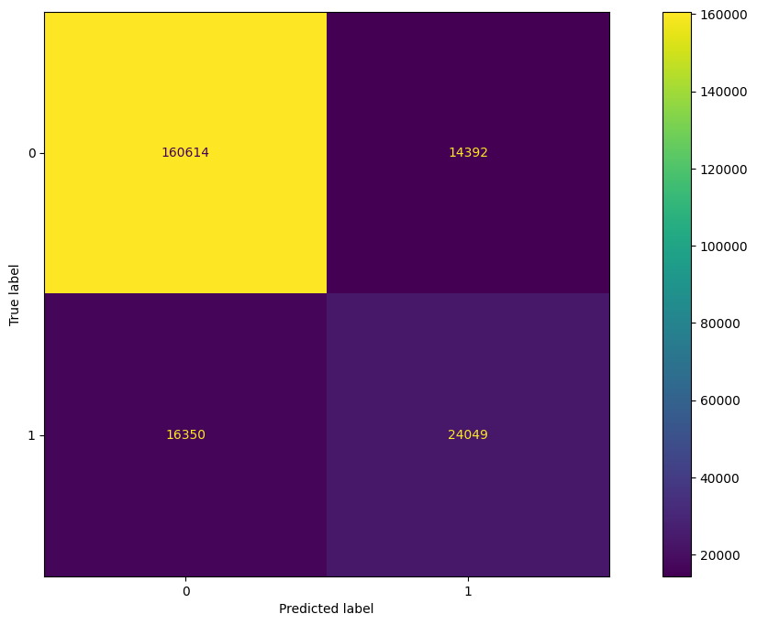
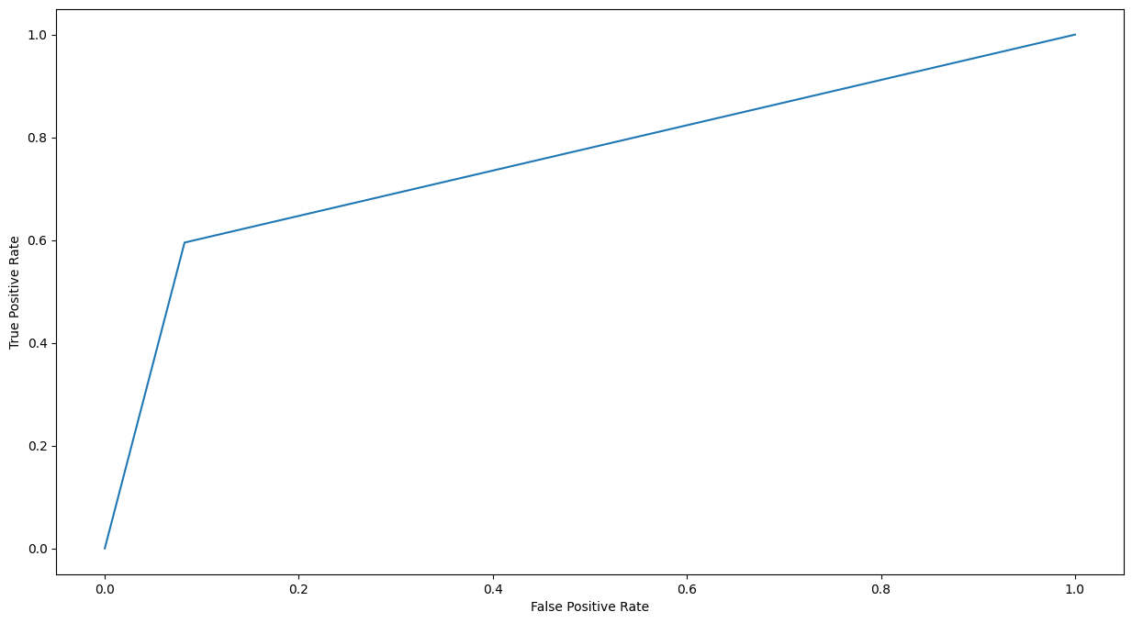

EXPRESSO CUSTOMER CHURN PREDICTION
(Modeling and Evaluation)
Model Evaluation-Logistic Regression
Evaluation
AUC :
The evaluation metric for this challenge is Area Under the Curve (AUC)
When working on a machine learning project, choosing the right error or evaluation metric is critical. This is a measure of how well your model performs at the task you built it for, and choosing the correct metric for the model is a critical task for any machine learning engineer or data scientist. Area Under Curve, better known as AUC, is used as an error or evaluation metric when evaluating a binary classification model.
Metrics for the selected model(Logistic Regression):

Slide 5
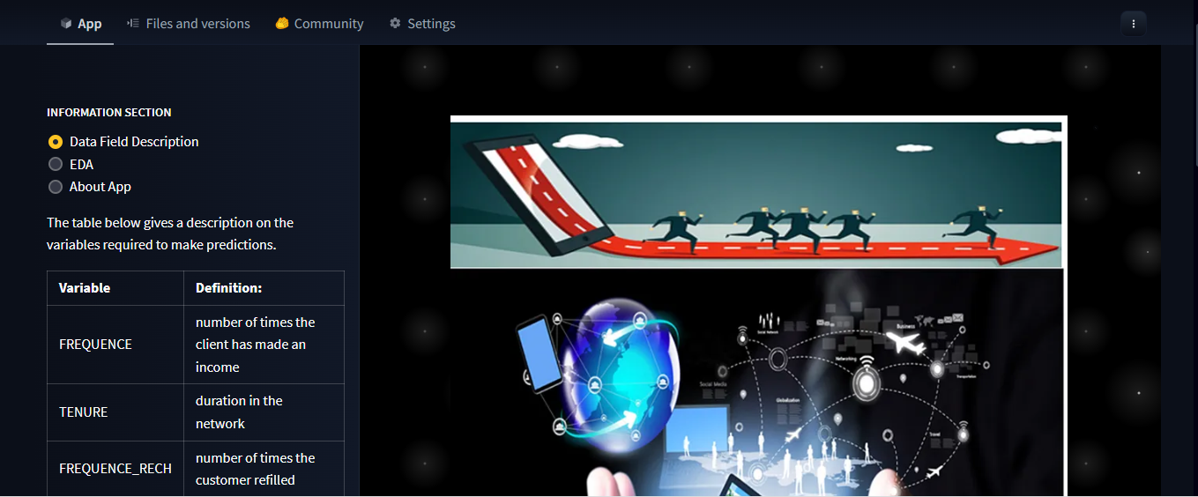
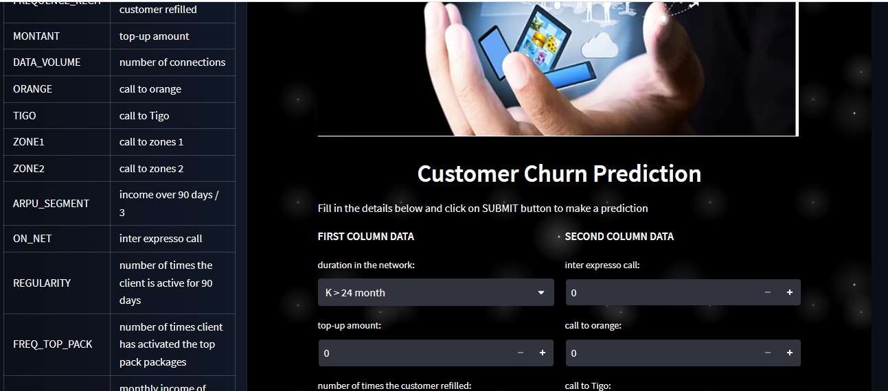
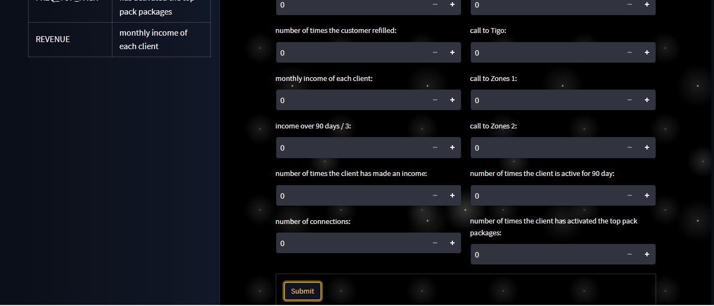
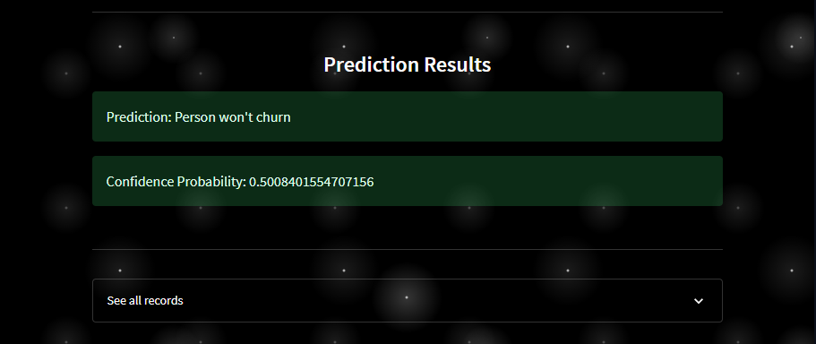
EXPRESSO CUSTOMER CHURN PREDICTION
(Deployment- App Development)
Deployment:
In order to start using my model for practical decision-making, it needs to be effectively deployed into production. If anyone cannot reliably get practical insights from my model, then the impact of my model is severely limited.
In order to get the most value out of my machine learning model, it was important to seamlessly deploy it into production so that Expresso Telecom can start using it to make practical decisions by using Streamlit.

Slide 6
THANK YOU

